Slide 1
軟體定義的儲存及 VMware Virtual SAN 5.5
2014 年 5 月

Slide 2
軟體定義的資料中心
配合應用程式需求將儲存裝置轉型
將虛擬運算擴展至所有應用程式
虛擬化網路以提升速度與效率
管理工具由 自動化所取代
Notes:
OK, let’s drill into the SDDC now.
I’m going to talk about each of these four components next.

Slide 3
軟體定義的資料中心
配合應用程式需求將儲存裝置轉型
Notes:
Let’s now switch gears and talk about storage, the third leg of the SDDC stool.
Storage is a key component of the data center and our SDDC story wouldn’t be complete without virtualizing storage.

Slide 4
現今的挑戰：儲存需求與複雜度大幅增加
儲存裝置成長
41%
YoY
資料來源：IDC，Yezhkova，全球企業儲存系統預測，2013 年 11 月，#244293
資料來源：IDC，2014 年儲存預測，2014 年 1 月，一般儲存 QuickPoll，#243511，n=307
Notes:
We are seeing the demand for storage grow exponentially
CLICK
Over the next two years, we are looking at a 41% increase in storage growth year over year
CLICK
There are multiple challenges related to storage
Number one: How do I meet my Service Level Agreements in the face of massive growth in both apps and storage demand?...
T: Today’s announcement goes way beyond not just an incremental improvement in storage…

Slide 5
儲存市場處於混亂局面
伺服器儲存
共用儲存
新形式
關鍵因素
20-30 年前
10-15 年前
現況
伺服器快閃記憶體
儲存裝置價格下滑
充裕的 CPU 週期
融合式虛擬管理程式 基礎架構
雲端經濟效益
Notes:
20 years ago, we had local attached disks in all servers. That resulted in islands of storage and poor utilization.
So we moved to shared storage with SAN and NAS arrays. That improved the TCO, but these boxes have become a large part of the IT cost.
Today, we’re finding new and innovative types of storage being built.
We’re seeing server flash become viable in terms of cost.
The cost of rotating media continues to plummet.
We find we have abundant cpu cycles in those servers so we can implement higher level functionality in software instead of firmware.
We’re seeing hyper-converged solutions that simplify the consumption of storage.
And, finally, we’re seeing object storage and cloud economics also significantly impact the overall cost of storage.

Slide 6
新儲存層正在快速成長
快閃記憶體：能達成新的
儲存架構
雲端：達成高成本效益儲存
雲端儲存
快閃記憶體比 HDD 快 50 – 2,000 倍
360GB MLC PCIe 卡能提供 110K/140K IOPs 讀/寫¹
每 IOP 低於 0.10 美元
免除將 100 顆 HDD 磁條化的需要
達成高效能的伺服器端儲存
高度可延展、隨收隨付
透過標準 API 存取
低容量成本
每月每 GB 0.05 美元²
預計將會每年以 40% 成長，一直到 2018 年³
1.資料來源：FuisionIO ioDrive2，2014 年 2 月
2.資料來源：Amazon S3，2014 年 2 月
3.資料來源：MarketsandMarkets 雲端儲存報告 - http://www.marketsandmarkets.com/PressReleases/cloud-storage.asp
Notes:
http://hexus.net/business/news/components/65773-rising-market-ssds-fails-halt-decline-storage-industry/
http://www.greenhousedata.com/blog/post/exploring-gartners-top-10-cloud-storage-trends/
http://www.marketsandmarkets.com/PressReleases/cloud-storage.asp

Slide 7
虛擬管理程式開創新機會
虛擬化平台：
即時瞭解所有應用程式的需求
直接位在 I/O 路徑上
能全面檢視底層基礎架構
不受硬體限制
vSphere
x86 伺服器
SAN / NAS
雲端儲存
Notes:
With the hypervisor, we have an opportunity to change how we address the storage challenge
The hypervisor is uniquely positioned in the stack to have visibility to:
CLICK
See what applications are running in VMs at any given time, and
CLICK
Have a global view of underlying infrastructure
Because it sits directly in the I/O path, the hypervisor has the unique ability to make optimal decisions around matching the demands of virtualized applications with the supply of underlying physical infrastructure.
The result is that the hypervisor enables a new approach to storage that puts the application in charge of defining its own storage requirements.
Virtualization is the gateway to enable a new way of provisioning and managing storage that lets software manage storage needs
T: We call this approach “Software-Defined Storage”

Slide 8
我們可以運用虛擬管理程式將儲存轉型
現況
軟體定義的儲存
透過以虛擬機為中心的原則自動化 SLA
(原則式的控制平台)
複寫
快照
虛擬機層級的資料服務
(虛擬資料服務)
LUN
LUN
融合式虛擬管理程式集區
SAN/NAS
集區
物件式
集區
LUN
抽象化和建立集區
(虛擬化的資料平台)
LUN
LUN
vSphere
陣列 A
陣列 B
x86 伺服器
雲端物件儲存
SAN / NAS
Notes:
Today
Device specific management
Rigid SLAs management from LUNs
Lack of VM awareness
Software-Defined Storage
Flexible resource management
Common control across heterogeneous resources
Granular VM-centric SLA management

Slide 9
軟體定義的儲存
將虛擬化的高效率運作模式帶到儲存裝置
原則導向控制平台
虛擬資料服務
Data Protection
行動力
效能
虛擬資料平台
融合式虛擬管理程式
儲存集區
SAN/NAS 集區
物件儲存集區
x86 伺服器
雲端物件儲存
Virtual SAN
SAN / NAS
Notes:
With Software-Defined Storage, we’re taking the operational model we pioneered in compute – and extending that to storage
Software-Defined Storage allows businesses to more efficiently manage their same storage infrastructure with software. How?
CLICK
First, Abstracting and pooling physical storage resources to create flexible logical pools of storage in the virtual data plane. We see three main pools going forward: SAN/NAS pool (enabled by VVOL), hypervisor-converged (enabled by Virtual SAN) and Cloud
CLICK
Second, providing VM-level data services like replication, snapshots caching, etc. from a broad partner ecosystem
CLICK
Lastly, enabling application-centric approach based on a common policy-based control plane. Storage requirements are captured for each individual VM in simple intuitive policies that follow the VM through its life cycle on any infrastructure. This policy-based management framework allows for seamless automation and orchestration, with the Virtual SAN software dynamically making adjustments to underlying storage pools to ensure application-driven policies are compliant and SLAs are met.
CLICK
Integration and interoperability with our storage ecosystem is a key element of our strategy. Across all elements SDS we plan to enable integration points through APIs that will allow our partners to enable value added capabilities on top of our platform.
Above are a list of partners that we have been working with to make the Software-Defined Storage solution a reality for our customers.
For example, EMC’s ViPR technology abstracts and pools third party external storage to create a virtual control plane for heterogeneous external storage. This is a great example of how Software-Defined Storage ecosystem vendors leverage the VMware platform to give customers more choice and the ability to transform their storage model.
Software-Defined Storage is using virtualization software to create a fundamentally new approach to storage that removes unnecessary complexity, puts the application in charge, and delivers many of the same benefits we see from SDDC… including simplicity, high performance, and increased efficiency.
T: Today, we’re excited to announce Virtual SAN…

Slide 10
VMware Virtual SAN 5.5
大幅簡化的融合式虛擬管理程式儲存

Slide 11
Virtual SAN：大幅簡化的融合式虛擬管理程式儲存
基本要件
內嵌在 vSphere 中的軟體定義的儲存
在任何標準的 x86 伺服器上執行
將 HDD/快閃記憶體集中至共用資料儲存區
透過儲存原則式管理架構管理
透過快閃記憶體加速提供高效能
高度彈性 – 在硬體故障時零資料損失
已與 VMware 堆疊深入整合
vSphere + Virtual SAN
…
SSD
硬碟
SSD
硬碟
SSD
硬碟
Virtual SAN 共用資料儲存區
Notes:
BEN TALKING:
Abstracts and pools server-side disks and flash => shared datastore
CLICK
Decouples software from hardware // Converts physical to virtual
Embedded in ESXi kernel to create high performance storage tier running on x86 servers
Policy-based management framework automates routine tasks
Creates a resilient, scalable storage tier that is easy to use
Gives users the flexibility to configure the storage they need
T: Virtual SAN is a true Software-Defined Storage product that runs on standard x86 servers, giving users deployment flexibility…

Slide 12
無與倫比的客戶利益及驗證
12,000+
Virtual SAN Beta 版參與者
95%
Beta 版客戶
建議 Virtual SAN
90%
相信 Virtual SAN 將會對儲存裝置帶來一如 vSphere 對於運算的改變
Notes:
We announced the public beta of Virtual SAN at Vmworld last year and it’s been a great success story.
We had over 10,000 registered participants
We’ve seen a lot of excitement and response from customers.
The team has over-achieved. We promised we’d deliver vSAN in the first half of 2014. As you know, that usually means June 32nd.
But I’m glad to announce that we’re almost ready and will be releasing vSAN ahead of schedule in Q1.
We also promised an 8-node solution for the first release, but I’m proud to announce that we’re going to support 16 nodes at GA.
Finally, to thank our Beta Customers, we’re offering a 20% discount on their first purchase.

Slide 13
為何採用 Virtual SAN？
大幅簡化
高效能
降低總持有成本 (TCO)
安裝簡便
單一虛擬管理介面
原則導向
自我調整
已與 VMware 堆疊整合
內嵌於 vSphere 核心
快閃記憶體加速
32 個節點最多達 2M IOPs
精密及線性延展
伺服器端經濟效益
無大量的前期投資
隨需增加
藉由強大的自動化輕鬆進行作業
不需要特殊專業技能

Slide 14
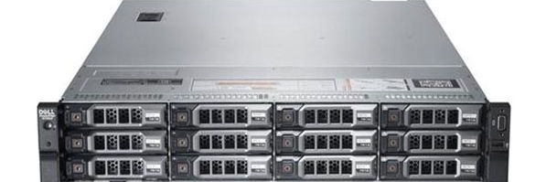
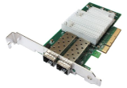
兩種建立 Virtual SAN 節點的方式
完全不需考量硬體
1.Virtual SAN 可用節點
2.專屬建立
預先設定使用 Virtual SAN 的伺服器…
選擇個別元件…
任何 在 vSphere 硬體相容性清單上的伺服器
SSD 或 PCIe
SAS/NL-SAS/ SATA HDD
HBA/RAID 控制器
…在提供正式版本時，會有 Cisco、IBM、Fujitsu 和 Dell 等 13 種不同選項
…使用《Virtual SAN 相容性指南》*
附註：若要進一步瞭解其他詳情，請參閱《Virtual SAN VMware 相容性指南》網頁
Virtual SAN 的元件必須從 Virtual SAN HCL 當中選擇，不支援使用任何其他元件
Notes:
BEN TALKING:
2 ways to deploy => ready node or component based
VSAN is completely HW independent
Flexibility of configuration to optimize for performance or capacity
Ready Node:
VMW working with OEM server vendors => “VIRTUAL SAN Ready Nodes”
Servers designed to make it easy to run Virtual SAN
Build Your Own:
VMW certifying VSAN to run on many different types of hardware
Servers, magnetic disks, solid state drives and controllers.
Gives you the flexibility to choose… build storage system based on your needs
VMware believes that a true Software-Defined Storage product gives users the flexibility when constructing storage architectures
T: VMware has been working with a broad array of ecosystem vendors to make this a reality…

Slide 15
彈性地設定效能和容量
效能
容量
 | 2xCPU – 8 核心 128GB 記憶體 | 2xCPU – 8 核心 128GB 記憶體 | 2xCPU – 8 核心 128GB 記憶體
 | 1x 400GB MLC SSD (~15% 的可用容量) | 1x 400GB MLC SSD (~10% 的可用容量) | 2x 400GB MLC SSD (~3% 的可用容量)
 | 5x 1.2TB 10K SAS | 7x 2TB 7.2K NL-SAS | 12x 4TB 7.2K NL-SAS
IOPS¹ 原始容量 | ~20-15K 6TB | ~15-10K 14TB | ~10-5K 48TB
1.混合工作負載 70% 讀取、80% 隨機
根據 2013 年市價估計，資金支出
(包括儲存硬體 + 軟體授權成本)

Slide 16
為 Virtual SAN 提供廣泛的合作夥伴商業網路支援
伺服器 / 系統 解決方案
儲存
Data Protectio 解決方案
16
Notes:
BEN TALKING:
We have built a robust, global eco-system around Virtual SAN
Includes all major server manufacturers and systems solutions..
Includes a broad range of hardware components such as controllers and disks…
And a variety of data protection solutions.
As part of the SDDC approach Pat laid out, it is VMware offer customers great flexibility of choice
T: In addition to being hardware independent, VSAN has a policy-based management framework built-in to simplify storage

Slide 17
Virtual SAN 具有預防任何硬體故障的高度彈性
Virtual SAN 的設計能確保資料不會在故障時遺失
極容易透過原則設定
以每個虛擬機為基礎提供
在磁碟、網路或主機故障時 零資料遺失
確保磁碟或網路故障時零停機 時間
可與 vSphere HA 及維護模式 交互運作
vSphere + Virtual SAN
Notes:
Virtual SAN automatically handles any error in the cluster
Availability levels set through the policy
Automatically rebuilds availability SLAs in case of failure
No data loss from:
I/O
Disk
Network
Host
==============================
-- Highly resilient zero data loss – leverage HA (lose host – move VMs)
-- Google/Facebook break-fix model efficient operations (separate slide)
Components accessible, but errors on I/O
Write Errors:
HDD marked degraded; SSD used to buffer writes
Failure propagated to object owner
Object recreation initiated on different components; on completion cluster directory updated
Reads still serviced from SSD’s
Read Errors:
If replica object exists, data returned; if not, IO error returned
Failure propagated to object owner
Object re-creation initiated - on completion cluster directory updated
SSD/HDD/Controller inaccessible
Actions:
If exists, data returned from replica object; if not, IO error returned
Failure propagated to object owner
Object re-creation initiated.
On completion Cluster Directory updated
Recovery from Node failure
If object reconstruction on H1 is complete, no action is taken
If object resync on H2 is deemed quicker, H2 copy is made replica, H3 copy is discarded.
Cluster directory updated appropriately

Slide 18
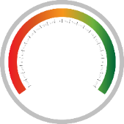
Virtual SAN 能以彈性、線性方式擴充效能和容量
不再需要複雜的預測及大量前期投資成本
彈性 隨需求成長或縮減
精密 可加入單一節點或磁碟
不中斷 無應用程式停機時間
水平擴充
加入更多節點
垂直擴充
加入更多磁碟
4.4 PB
「Virtual SAN 可讓我們擴充我們的儲存基礎架構，同時提供必要的備援。如此能讓我們更為靈活，並更快將我們的解決方案上市。」
400 TB
40 TB
容量
IOPS
— Frans Van Rooyen
Adobe 雲端架構工程師
Notes:
Make text look nicer - Tom

Slide 19
Virtual SAN 能提供企業級的擴充能力
每個 Virtual SAN 叢集最大的延展性
32
主機
3,200
虛擬機
「Virtual SAN 可讓我們建立像是 Facebook 和 Google 般可延展的異質儲存基礎架構環境。Virtual SAN 可讓我們擴大規模、加入資源，同時能提供高效能工作負載服務。」
2M
IOPS
4.4
PB
— Dave Burns
Cincinnati Bell 技術營運副總裁
Notes:
BEN TALKING:
Beyond the big numbers on this page….
…Virtual SAN scales to the needs of your environment
Powerful storage tier running on heterogeneous server hardware
Most importantly…scales to the needs of customers.
32 node VSAN cluster
4.4 TBs of capacity
2M IOPs
3,200 VMs
Not a toy
Ideal and viable storage tier for vSphere environments
VSAN is high performance, scalable and resilient… and runs on heterogeneous hardware
JOHN TALKING
That’s great, Ben. Couldn’t you just add more hardware to any other storage technologies in the market today to increase capacity?
T: What is impressive about Virtual SAN is not just its maximum capacity or IOPs… it is its efficiency and how it gets to these numbers…

Slide 20
具備彈性及 線性延展性的高效能
在 32 個節點叢集中最多達 2M IOPs
VDI 密度比得上所有快閃陣列
註：以 IOmeter 指標為基準測試
混合 = 70% 讀取、4K 80% 隨機
註：以 View Planner 基準測試為基礎
Notes:
BEN TALKING
Yes… Virtual SAN scales to 32 nodes and 2M IOPs, but it does so in a predictable and linear fashion
This is particularly helpful if you are trying to forecast storage capacity….
… or have a latent application in need of more performance
Virtual SAN gives you the ability to granularly scale-up or scale-out your cluster
Add more resources to achieve an intended outcome
One customer quote I liked from the beta was … “We can customize IO and capacity on demand”
Eliminates costly overprovisioning
Pause…
As customers look for every edge possible about efficiency, Virtual SAN delivers on this
This gives you the control to have Google-like and Amazon-like efficiency within your private cloud
On the left…
Linear and Predictable performance
Scales with your environment
Same functionality across different types of workloads
On the right…
High VM density in VDI environments.
Performance isn’t a constraint
VSAN has VM densities comparable to an all-flash array

Slide 21
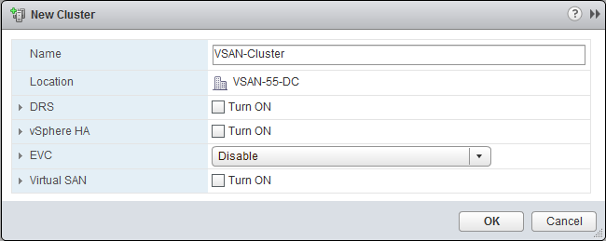
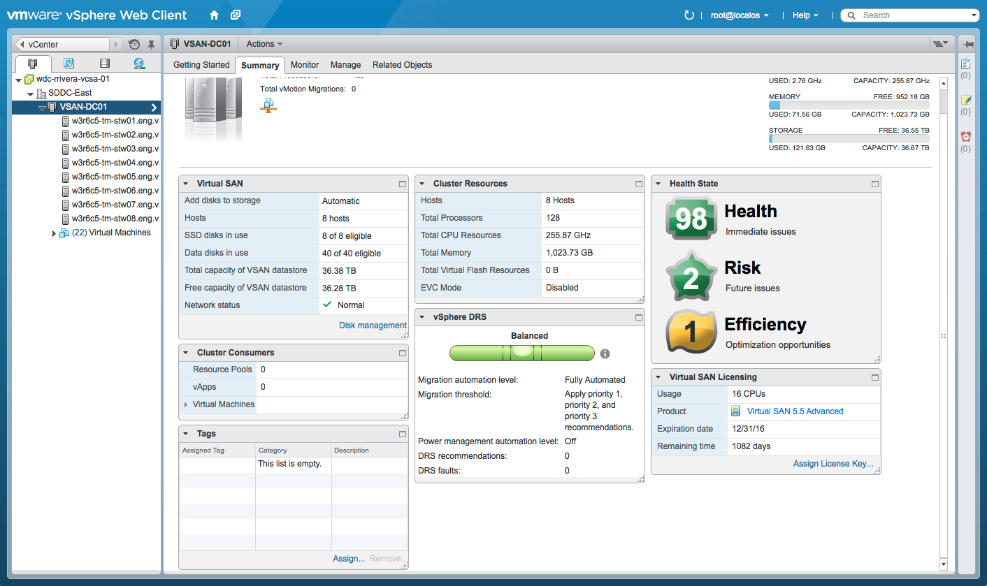
Virtual SAN 能簡化儲存
如果您知道 vSphere，那您一定瞭解 Virtual SAN
按幾下即可完成部署！

Slide 22
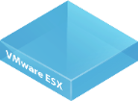
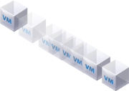
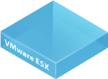
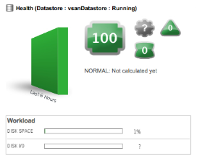
Virtual SAN 已與 VMware 堆疊深入整合
非常適合 VMware 環境
vSphere
Data Protection
虛擬桌面平台
vMotion
vSphere HA
DRS
Storage vMotion
快照
連結複製
VDP Advanced
vSphere Replication
VMware View
雲端作業與自動化
災難復原
儲存原則式管理
vCenter Operations Manager
Site Recovery Manager
vCloud Automation Center
IaaS (基礎架構即服務)
站點 A
站點 B
Notes:
(SLIDE AUTOMATICALLY BUILDS)
BEN TALKING:
Interoperability a key differentiator for Virtual SAN
Makes the product easy to use for our customers
[GO AROUND TO TALK THROUGH PRODUCTS]
High degree of convenience … makes storage simple for customers
John:
This is great to hear that Virtual SAN is resilient and interoperates with other VMware products. Could you show me how this works?
BEN:
Sure
T: Let me show you how this works in the product

Slide 23
Virtual SAN 讓應用程式負責主導
透過以應用程式為中心的方法簡化且自動化的儲存管理
現況
Virtual SAN
現況
1.預先定義儲存組態
2.預先配置靜態容器
3.顯示預先配置的容器
4.選擇適當的容器
5.使用預先配置的容器
1.定義儲存原則
2.建立虛擬機時套用原則
自動佈建並維持資源與資料服務。
Virtual SAN 共用資料儲存區
過度佈建 (寧願安全不要遺憾！)
浪費資源、浪費時間
頻繁的資料移轉
無過度佈建
較省資源、較省時間
變更簡易
Notes:
Challenges
Difficult to forecast right
Difficult to change policies once allocated
Difficult to change apps to new policies
What Happens
Overprovisioning (better safe than sorry!)
Wasteful of resources, wasteful of time
Difficult and complex

Slide 24
Virtual SAN 簡化和自動化儲存管理
依單一自我調整資料儲存區的每個虛擬機儲存服務層級
每個虛擬機 儲存原則
根據應用程式的 需求設定原則
服務層級的 軟體自動化控制
容量
儲存原則式管理
效能
vSphere + Virtual SAN
SLA
可用性
Virtual SAN 共用資料儲存區
「Virtual SAN 非常容易部署，只需勾選幾個核取方塊即可，不需要設定 RAID。」
— Jim Streit
Thomson Reuters IT 架構工程師
不再需要 LUN/磁區！
Notes:
BEN TALKING:
SPBM framework allows you to define storage requirements based on application needs.
CLICK
It is simple => capacity, performance and availability
CLICK
VSAN matches requirements to underlying capabilities.
Unlike traditional external storage => provisioning done at array layer
Automation: policies governed by SLAs
CLICK
Orchestration: software abstracts underlying hardware
End result => No more LUNs of Volumes…
T: To give you a better idea, let me show you how all of this works together (DEMO)
John:
You mentioned policy-based framework. Help me understand how that works as I believe that is a fairly new concept when it comes to storage.

Slide 25
Virtual SAN 能降低資金支出及營運成本，以獲得更佳的總持有成本 (TCO)
資金支出
伺服器端經濟效益
無光纖通道網路
隨需增加
營運成本
簡化的儲存組態設定
無 LUN
直接在 vCenter 中管理
自動化虛擬機佈建
簡化的容量規劃
最低至 0.25 美元/ IOPS
每桌面平台的價格僅 50 美元*
最低至 0.50 美元/ GB
低 5-10 倍的營運成本
降低最多達 50% 的總持有成本 (TCO)
完整複製
依據 2013 年市價和資金支出進行估算 (包括儲存硬體 + 軟體授權成本)
Notes:
Drivers on the right – Arrow – Bubbles (with range) $2.5GB
50% tco reduction
5-10x opex
Align Costs with Revenue
Take advantage of decreasing HW prices

Slide 26
彈性地設定效能和容量
效能
容量
 | 2xCPU – 8 核心 128GB 記憶體 | 2xCPU – 8 核心 128GB 記憶體 | 2xCPU – 8 核心 128GB 記憶體
 | 1x 400GB MLC SSD (~15% 的可用容量) | 1x 400GB MLC SSD (~10% 的可用容量) | 2x 400GB MLC SSD (~3% 的可用容量)
 | 5x 1.2TB 10K SAS | 7x 2TB 7.2K NL-SAS | 12x 4TB 7.2K NL-SAS
IOPS¹ 原始容量 | ~20-15K 6TB | ~15-10K 14TB | ~10-5K 48TB
0.32 美元/IOPS
2.12 美元/GB
0.57 美元/IOPS
1.02 美元/GB
1.53 美元/IOPS
0.48 美元/GB
1.混合工作負載 70% 讀取、80% 隨機
依據 2013 年市價和資金支出進行估算 (包括儲存硬體 + 軟體授權成本)

Slide 27
精密的延展能消除過度佈建
提供可預測的延展及控制成本的能力
激增係對應 IOPs 需求產生水平擴充
Virtual SAN 能達到可預測的線性延展
與大型外部儲存裝置相比
依據 2013 年市價和資金支出進行估算 (包括儲存硬體 + 軟體授權成本)
額外節省係基於自動化所帶來的營運成本縮減
Virtual SAN 組態：每一個核心有 9 個虛擬機，每個虛擬機有 40GB 可用，有 2 個複製可用，且採用 10% SSD 來達成效能

Slide 28
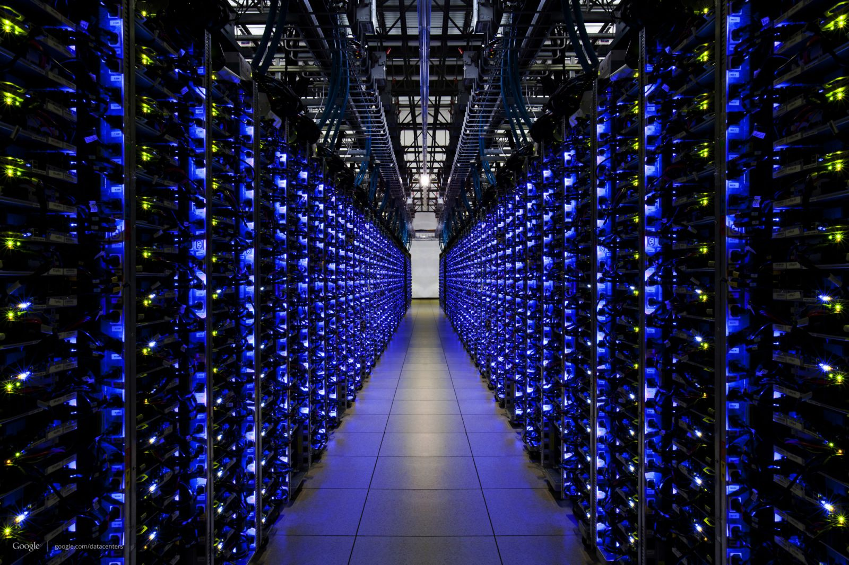
經營像 Google 般的資料中心
模組化基礎架構。中斷 – 取代作業
「從錯誤修正的觀點，我認為它對於硬體故障時所需採取的措施帶來重大的差別。 我可以指派我團隊中的任何一個組員前去更換一個 1U 或 2U 伺服器。…這樣的作法能將我的資料中心模組化，並提供真正的軟體定義的儲存架構。」
— DOE Fund IT 主任， Ryan Hoenle
Notes:
Increase the performance
Get better economics
Save on CPU resources
--
So the cost of an I/O, in CPU cycles and overhead, is important. Gray and Shenoy derive some rules of thumb for I/O costs:
A disk I/O costs 5,000 instructions and 0.1 instructions per byte
The CPU cost of a Systems Area Network (SAN) network message is 3,000 clocks and 1 clock per byte
A network message costs 10,000 instructions and 10 instructions per byte
for an 8KB I/O, which is a standard I/O size for Unix systems, it costs
Disk: 5,000 + 800 = 5,800 instructions
SAN: 3,000 + 8,000 = 11,000 clocks
Network: 10,000 + 80,000 = 90,000 instructions
Thus it is obvious why IDCs implement local disks in general preference to SANs or networks. Not only is it cheaper economically, it is much cheaper in CPU resources. Looked another way, this simply confirms what many practitioners already have ample experience with: the EDC architecture doesn’t scale easily or well.
------------------
Two I/O intensive techniques are RAID 5 and RAID 6. In RAID 5, writing a block typically requires four disk accesses: two to read the existing data and parity and two more to write the new data and parity (RAID 6 requires even more). Not surprisingly, Google avoids RAID 5 or RAID 6 and favors mirroring, typically mirroring each chunk of data at least three times and many more times if it is hot. This effectively increases the IOPS per chunk of data at the expense of capacity, which is much cheaper than additional bandwidth or cache.

Slide 29
Virtual SAN 使用案例
Virtual SAN 5.5 使用案例
虛擬桌面平台
(VDI)
第 2 層 / 第 3 層 / 接移
災難復原目標
站點 A
站點 B
「Virtual SAN 的簡單儲存設定方式，並具備將我們的第 2 層與第 3 層工作負載擴充為具吸引力技術的能力，與傳統 SAN 或 NAS 相比，Virtual SAN 能大幅降低佈建及管理儲存裝置的複雜性。」
「Virtual SAN 可讓我們在都會區建立地理分散的叢集，以達成以往所無法提供的備援層級。更重要的是，Virtual SAN 能為私有雲基礎架構提供無可比擬的總持有成本 (TCO)。」
「Virtual SAN 非常容易使用，並可讓我們使用現有的硬體水平擴充 VDI 環境，而不會影響我們現有的儲存環境。」
與 vSphere Replication 和 VMware SRM 整合
減少儲存成本
最小化資料中心佔位面積
處理尖峰效能需求 (開機、登入、讀取/寫入爆量)
從 POC 精密擴充至生產，而不需要大量前期投資
支援高 VDI 密度
快速儲存佈建及完全自動化
理想的價格/效能
能讓雲端架構設計師更容易地佈建儲存
— OfficeMax 系統管理員， Joshua Stark
— Cincinnati Bell 技術營運副總裁， Dave Burns
— Travelocity.com 系統管理員， Harry Le
Notes:
There are two motivating reasons to sell vCHS. The first is to help you get to your quota faster. Compensation is based on Annual Contract Value. So with $180k average first engagement deal size for Dedicated Cloud and $15k for Virtual Private Cloud, means that the more vCHS you sell, the more money you will make, and the faster you will get to your goal.
The other is around gaining better account control. By selling just software today, you are only involved in ½ the conversation. With vCHS you will be selling a service which will help to create an annuity stream of revenue for you going forward.

Slide 30
其他資源
產品頁面 http://www.vmware.com/tw/products/virtual-san/
Virtual SAN 社群 https://communities.vmware.com/community/vmtn/vsan
VIP 工具 vip.vmware.com/salessignup
虛擬實機操作教室 http://vmware.com/go/vsanlab
Virtual SAN 60 天免費評估 https://www.vmware.com/tw/try-vmware
軟體定義的儲存銷售團隊 sdssales@vmware.com
Notes:
Education class

Slide 31
感謝您
備用聯絡資訊

